Slide 1

QuadTree Visualizer
TERNA ENGINEERING COLLEGE
Department of Computer Engineering
Nerul (W), Navi Mumbai 400706
Group ID: TN04CS73
Under the Guidance of : Prof. Randeep Kaur Kahlon
Group Members:
AMEY THAKUR | TU3F1819127
HASAN RIZVI | TU3F1819130
MEGA SATISH | TU3F1819139
AJAY DAVARE | TU3F1718006

Slide 2
ABSTRACT
Many digital map applications have the need to present large quantities of precise point data on the map. Such data can be weather information, the population in towns, etc. With the advancements in data science/ML, we expect such data will grow at a rapid pace. How to visualize such magnitude of data becomes a problem. QuadTree is a data structure in which each internal node has exactly four children. Quadtrees are trees implemented to efficiently store data of points on a two-dimensional space. This project aims to build an efficient visualizer for interactively visualizing the data. In this project, we will be using collision detection to illustrate the functionalities of QuadTree.

Slide 3
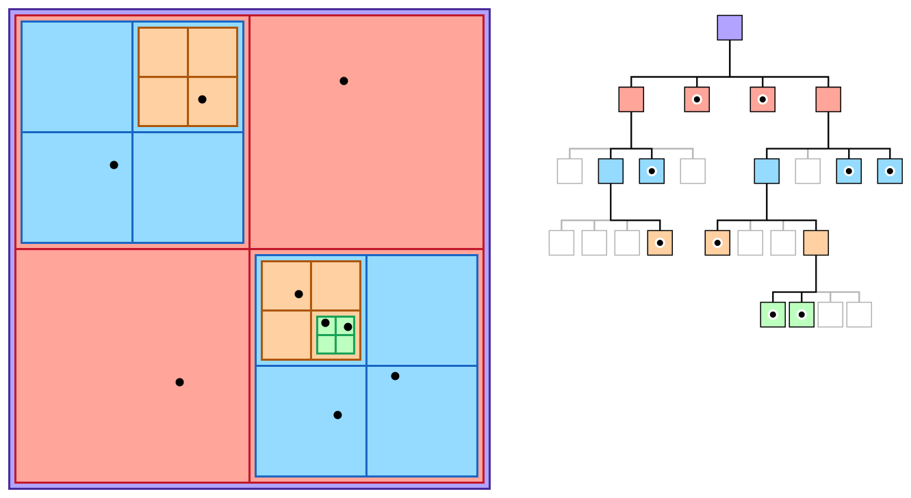
INTRODUCTION
What is QuadTree?
A data structure for organizing objects based on their locations in a two-dimensional space.

Slide 4
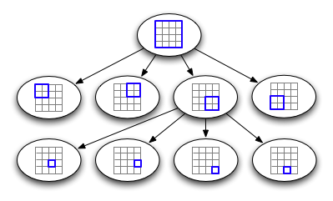
INTRODUCTION
The QuadTree partitioning strategy divides space into four quadrants at each level. When a quadrant contains more than one object, the tree subdivides that region into four smaller quadrants, adding a level to the tree.
So to speak in layman’s term, a quadtree is a tree whose nodes either are leaves or have 4 children. The children are ordered 1, 2, 3, 4.

Slide 5
OBJECTIVES
This project's objective is to implement a quadtree visualizer that can be helpful in understanding working of QuadTree.
QuadTree aims to be:
Versatile (can be used in dynamic and static contexts)
Simple
Lightweight
Easy to use
Fast

Slide 6
SCOPE
We propose to develop a QuadTree library and a visualization tool for the same.
This project aims to build an efficient visualizer for interactively visualizing the data.
In this project, we will be using collision detection to illustrate the functionalities of QuadTree.

Slide 7
LITERATURE SURVEY
Author’s Name | Title and Year of Publication | Findings
Irene Gargantini Qing Cai, Yimin Zhou | An effective way to represent quadtrees, 1982 | This paper proposes a new structure very similar to quadtree, called as “linear quadtree” and different algorithms used to represent that structure. The linear quadtree saves 66% of the computer storage required by regular quadtrees.
Clifford A.Shaffer, Hanan Samet | Optimal quadtree construction algorithms, 1987 | In this paper, an algorithm for constructing a quadtree in time proportionate to the number of blocks in a given picture is described.
Qing Cai, Yimin Zhou | A quadtree-based hierarchical clustering method for visualizing large point dataset, 2016 | This paper introduces a new clustering method with quadtree spatial indexing. It explains a grid- based, partitioning, hierarchical clustering method on quadtree file system storage.

Slide 8
PROBLEM STATEMENT
The importance of data nowadays has increased significantly, as we are living in a data driven society. Many digital map applications have the need to present large quantities of precise point data on the map. With the development of the , we expect such data will grow at a rapid pace. However, visualizing and looking for a data point in such a magnitude of data becomes a problem. We are proposing the implementation of a quadtree visualizer to visualize data more easily.

Slide 9
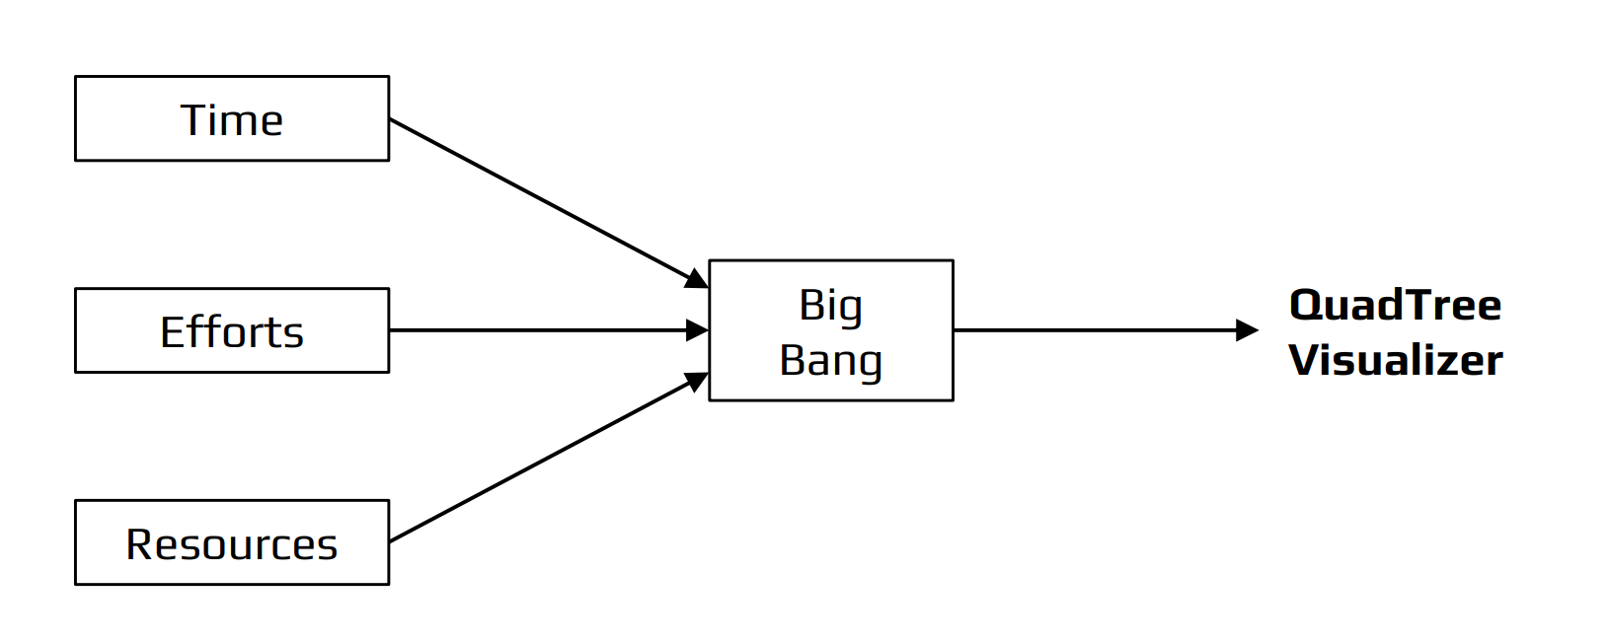
THE BIG BANG MODEL

Slide 10
THE BIG BANG MODEL
There is no planning required for this.
Suitable for small projects.
Very few resources are required.
As there is no proper planning hence it does not require managerial staffs.
Easy to implement.
It develops the skills of the newcomers.
Very much flexible for the developers working on it.

Slide 11
REQUIREMENTS, TOOLS & TECHNOLOGIES
Software Requirements
GitHub
VSCode
Web Browser
Hardware Requirements
4 GB RAM
Any Operating System
Tools Used
NPM Dependencies
CMD/Terminal
Technologies Used
HTML 5.0
CSS 3.0
JavaScript, v. ES13
TypeScript, v.4.6.3
Node.js, v17.9.0
Next.js, v10.0.5
React, v17.0.1

Slide 12
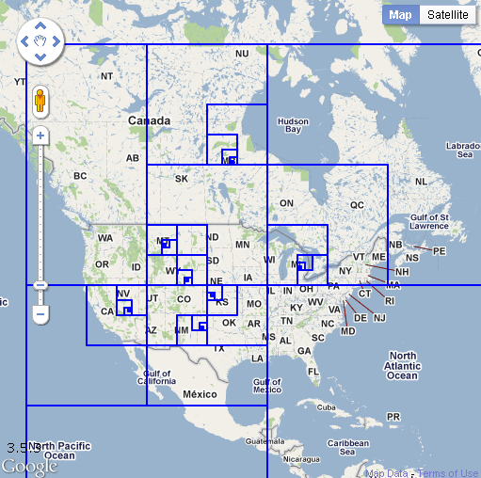
USE CASES
Use Cases of QuadTree includes:
Image Processing
Sparse Data Storage
Spatial Indexing
Examples:
Computer Graphics, Games, Movies
Computer Vision, CAD, Street Maps
(Google Maps/Google Earth)
Visualization (Graphing Complex Functions)

Slide 13
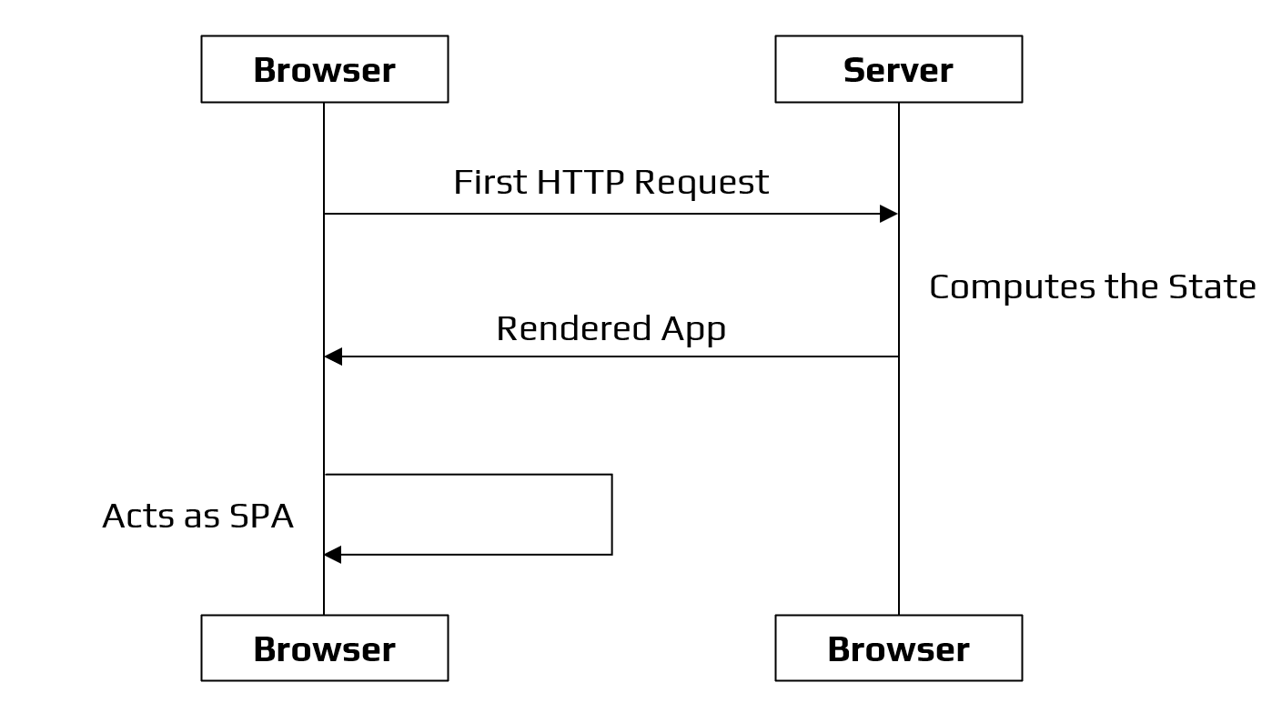
MODEL ARCHITECTURE

Slide 14
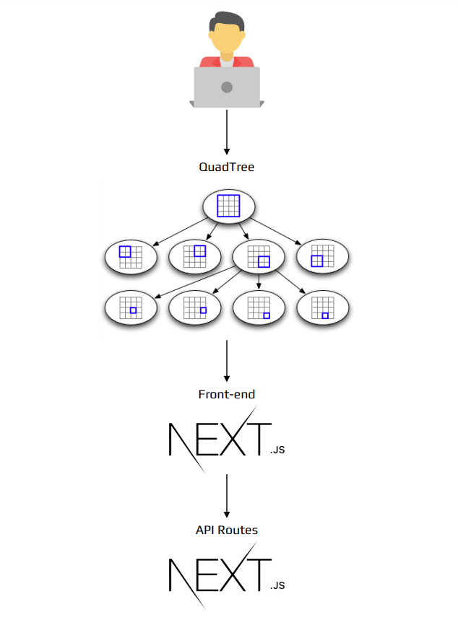
WORKFLOW OF QUADTREE VISUALIZER

Slide 15
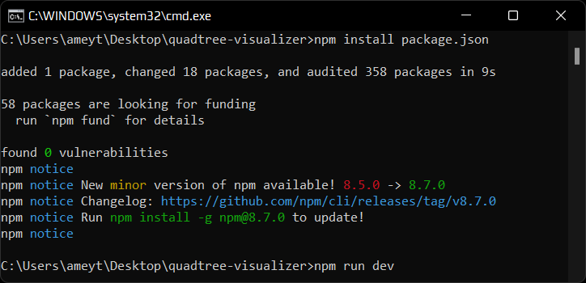
EXPERIMENTAL SETUP
Since we are using Next.js in our project, we first need to have Node.js. The web application is currently working on http://localhost:3000.
To run the application locally, we need to install the packages required using the npm command: npm install package.json

Slide 16
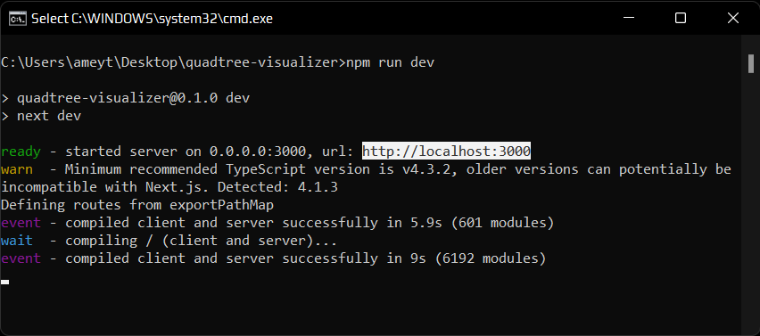
EXPERIMENTAL SETUP
After installing all the dependencies, we then run the command: npm run dev. This command will run the developer server.

Slide 17
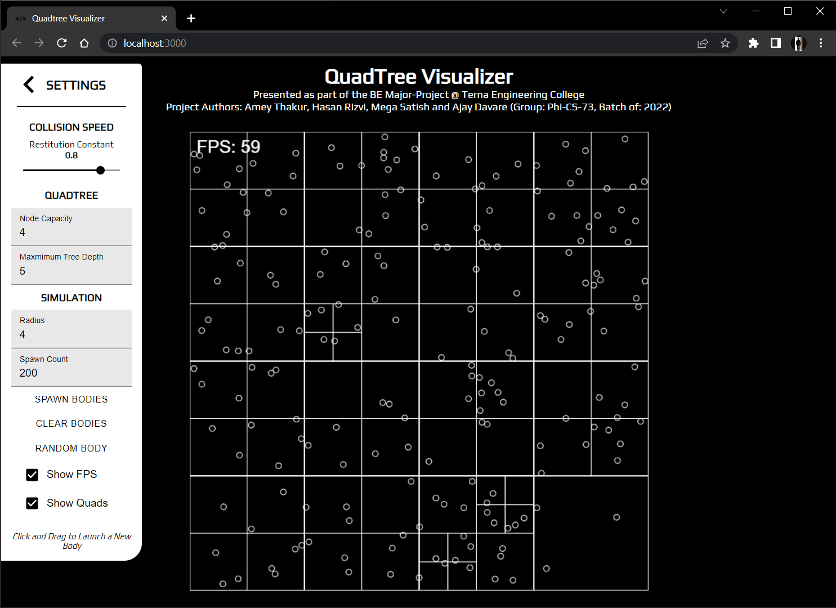
SNAPSHOTS
Homepage

Slide 18
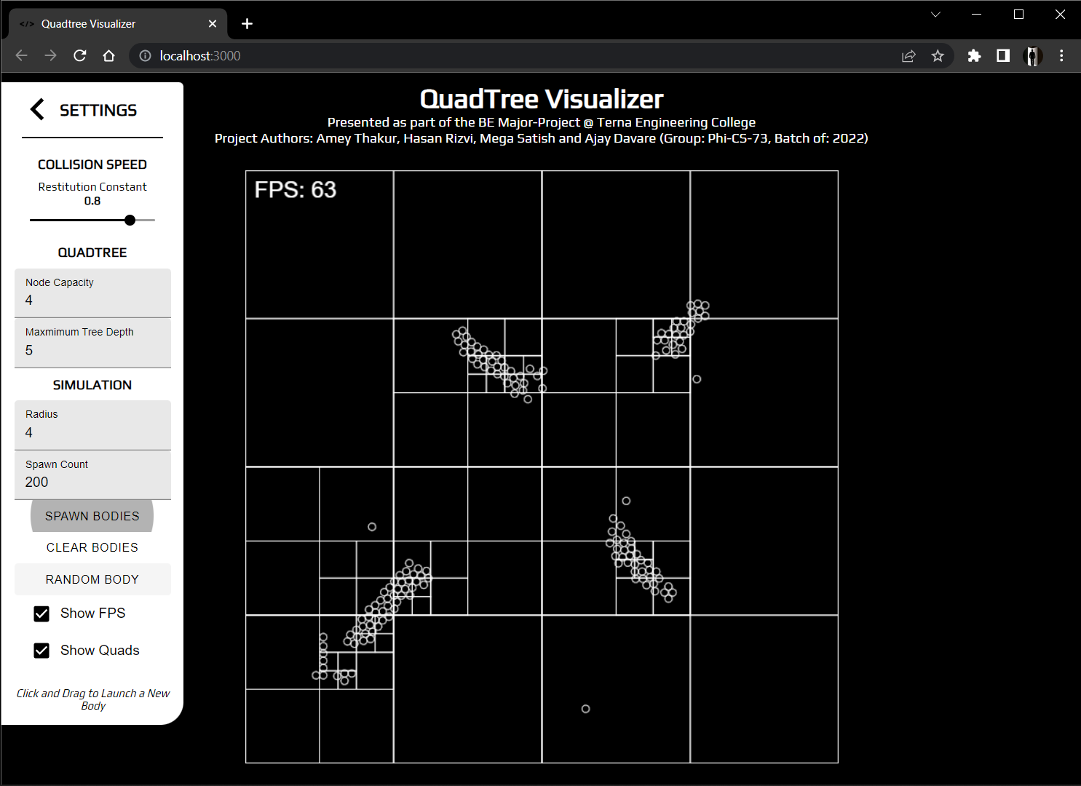
SNAPSHOTS
Spawn Bodies

Slide 19
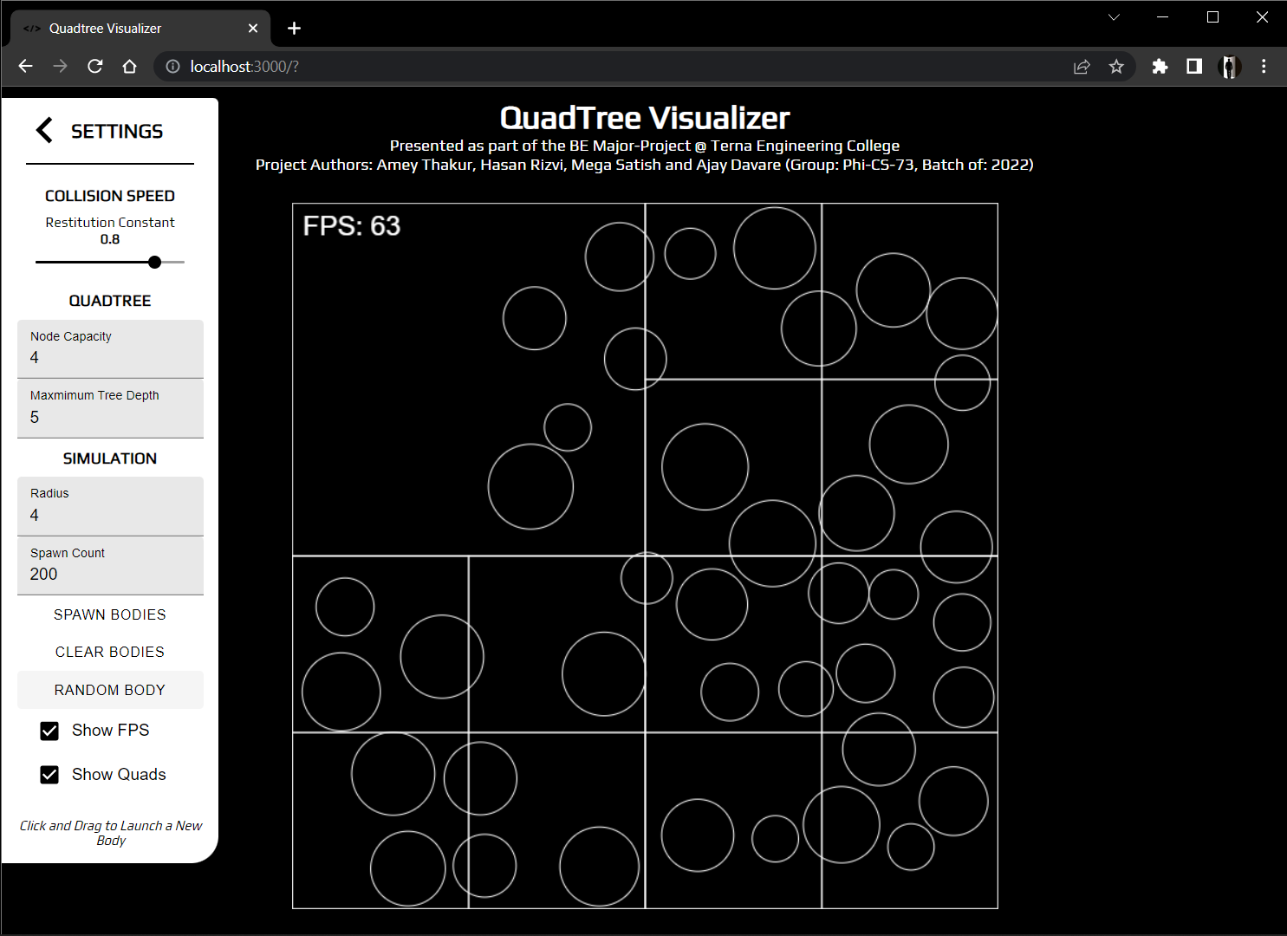
SNAPSHOTS
Random Bodies

Slide 20
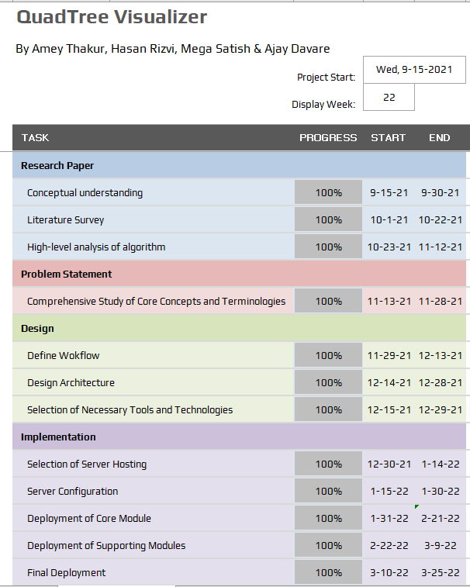
PROJECT PLAN

Slide 21
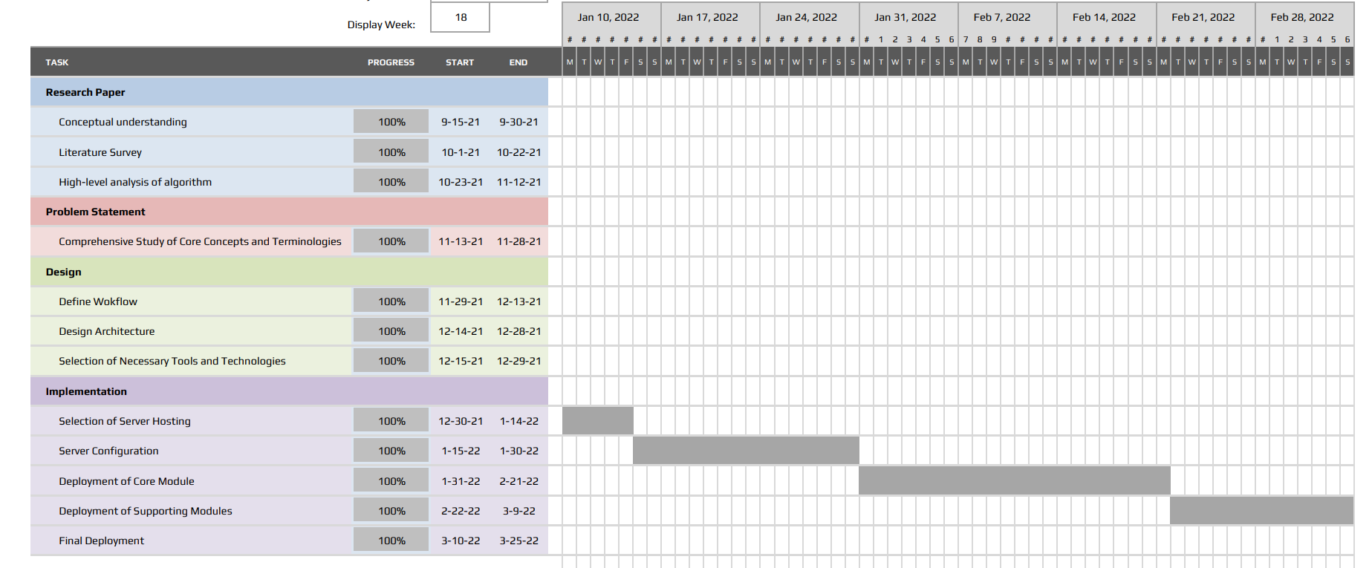
GANTT CHART

Slide 22
CONCLUSION
It can be concluded quadtrees are extremely powerful data structures that are still heavily under-utilised in both the industry and community applications. By the time of completion of this project we’ve learned to develop scalable and reusable codebases for large projects, understood the fundamentals of API build and interaction, developed a visualization tool and understood how to function in a time-bound manner and collaborate at scale across various tasks and disciplines.

Slide 23
WHAT HAVE WE LEARNT SO FAR…
To adopt the practice of pair-programming and co-ordinate in a group to develop the project.
To develop scalable and reusable codebases for large projects.
To understand the fundamentals of API build and interaction.
To be acclimatised with a unique data structure like Quadtree
To understand the scope of research and public work still needed to fully utilise the power of this data structure.
To know how to function in a time-bound manner and collaborate at scale across various tasks and disciplines.

Slide 24
RESEARCH PAPER
Paper Citation
Randeep Kaur Kahlon, Amey Thakur, Hasan Rizvi, Mega Satish, Ajay Davare. “QuadTree Visualizer”, Volume 11, Issue 4, International Journal of Engineering Research & Technology (IJERT), 2022, ISSN: 2278-0181, www.ijert.org

Slide 25
REFERENCES
[1] | Q. Cai and Y. Zhou, "A quadtree-based hierarchical clustering method for visualizing large point dataset," 2016 Sixth International Conference on Information Science and Technology (ICIST), 2016, pp. 372-375, doi: 10.1109/ICIST.2016.7483441.
[2] | “An effective way to represent quadtrees” Communications of the ACM, Volume 25, Issue 12, Dec 1982 pp 905–910, doi:10.1145/358728.358741.
[3] | “Optimal quadtree construction algorithms” Computer Vision, Graphics, and Image Processing, Volume 37, Issue 3, March 1987, pp 402–419, doi:10.1016/0734-189X(87)90045-4.
[4] | Sullivan, Gary J., and Richard L. Baker. "Efficient quadtree coding of images and video." IEEE Transactions on image processing 3, no. 3 (1994): 327-331
[5] | Berg, Mark de, Marcel Roeloffzen, and Bettina Speckmann. "Kinetic compressed quadtrees in the black-box model with applications to collision detection for low-density scenes." In European Symposium on Algorithms, pp. 383-394. Springer, Berlin, Heidelberg, 2012.
[6] | Sharma, Praveen K., and Harish N. Dixit. "Energetics of a bouncing drop: Coefficient of restitution, bubble entrapment, and escape." Physics of Fluids 32, no. 11 (2020): 112107.
[7] | Mathew, Reji, and David S. Taubman. "Quad-tree motion modeling with leaf merging." IEEE Transactions on Circuits and Systems for Video Technology 20, no. 10 (2010): 1331-1345.
[8] | Tilkov, Stefan, and Steve Vinoski. "Node. js: Using JavaScript to build high-performance network programs." IEEE Internet Computing 14, no. 6 (2010): 80-83.
[9] | Fenton, Steve, Fenton, and Spearing. “Pro TypeScript.” Apress, 2014
[10] | Cantelon, Mike, Marc Harter, T. J. Holowaychuk, and Nathan Rajlich. “Node. js in action.” Greenwich: Manning, 2014.

Slide 26


